Slide 1

Evolving Energy Realities: Adapting to What’s Next
New England Electricity Restructuring Roundtable: The Role of Natural Gas
Melanie Kenderdine
June 12, 2020
Notes:
Thanks so much for the invite, feels like hold home week
Spent a great deal of time working with my colleagues from Canada when I was at DOE – QER, hockey game in Winnipeg, Mexico City Montreal, G7 Energy Security Principles, Mssion Innovation etc.
Special relationship between our two countries is very special to me – and my grandfather was from Canada, served in WWI in Canadian forces, Kenderdine Art Gallery in saskatchwean
EFI what we do
Slides will reflect our work and type of work we do

Slide 2

Top 10 States Unemployment Claims (3/16-05/02), Top 10 States for Employment in Key Energy Job Categories (2019)
Ranking of Top 10 States, Highest to Lowest | Total Unemploy-ment Claims (03/16-05/02) | Claims as % of Workforce | Natural Gas and Oil Fuels Jobs Actual | Natural Gas and Oil Fuels Jobs as % of Workforce | Efficiency Jobs Actual | Efficiency Jobs as % of Workforce | Gas/Oil Generation Actual | Gas/Oil Generation as % of Workforce | Solar Generation Jobs Actual | Solar Generation Jobs as % of Workforce | Wind Generation Jobs Actual | Wind Generation Jobs as % of Workforce
1 | CA | KY | TX | WY | CA | VT | CA | KS | CA | NV | TX | ND
2 | NY | GA | LA | ND | TX | WY | FL | HI | MA | HI | IL | SD
3 | TX | HI | OK | AK | NY | DE | TX | NH | NY | CA | CO | CO
4 | FL | RI | CA | OK | FL | RI | KS | UT | FL | VT | IN | IA
5 | GA | NV | PA | LA | IL | MA | NY | FL | TX | UT | CA | IN
6 | MI | MI | CO | NM | MA | MD | MA | AK | NV | MA | FL | ME
7 | PA | WA | NM | TX | NC | WI | IL | MA | AZ | NM | MI | TX
8 | OH | NH | IL | WV | MI | OR | AZ | SC | NJ | OR | IA | NH
9 | NJ | LA | ND | CO | OH | UT | MI | AZ | NC | AZ | NY | KS
10 | WA | MA | OH | KS | VA | CT | OH | MS | OH | CO | WA | IL
Total US* | 30,300,990 |  | 906,998 |  | 2,378,893 |  | 128,031 |  | 345,393 |  | 114,774
Bold denotes top 10 states that are in top 10 for actual unemployment claims or claims as percent of workforce and are also in top 10 jobs for specific energy sector, both actual and as % of workforce
* Includes DC, Puerto Rico
COVID and Energy Jobs

Slide 3
Installed Capacity and Summer Capacity Supply Obligations, 2019 (MW)
Summer Capacity Supply, 2019 (MW)
Installed Capacity in New England, 2019 (MW)
Summer Capacity Supply Obligation, MW
Battery, Energy Storage……................5
Coal……………………………………..….....917
Co-located, PV/Battery………....………..0
Fuel Cell…………..……….…….....………...23
Hydro…………....……………….………..1,422
Landfill/Other Biomass Gas.............54
Natural Gas...............................15,803
Nuclear.......................................4,343
Oil..............................................6,618
Photovoltaic………………………………….63
Pumped Storage……………….……...1,682
Refuse………………………………………...390
Steam…………………………………........…..0
Wind……………………………………...…..112
Wood………………………………….……….449
Demand Capacity…..…………….…..3,088
Total Capacity……………………......35,396

Slide 4
Reference Frames for Installed Capacity/ Dispatchable Technologies: 100% Wind & Solar Replacing Oil, Gas & Nuclear
2019 Summer Capacity Obligations/Avg. Capacity Factors*
2019 Installed Capacity/Avg. Capacity Factors*
MW Capacity Needed to Replace Gas, Oil & Nuclear Capacity
15,803 MW Natural Gas Capacity Factor 67%
4,343 MW Nuclear Capacity Factor 93.5%
6,618 MW Oil Capacity Factor 15%
15,803 MW Natural Gas Capacity Factor 67%
4,343 MW Nuclear Capacity Factor 93.5%
6,618 MW Oil Capacity Factor 15%
Square Miles Land Needed*
63 MW Solar PV Capacity Factor 24.5%
57
4051 MW Solar PV Capacity Factor 24.5%
59,826
112 MW Wind Capacity Factor 35% (onshore)
194
2836 MW Wind ** Capacity Factor 35% (onshore)
41,878
Source: land use for wind solar NREL, 10 MW PV 6.1 acres, 10 MW onshore wind 44.7 acres, 640 acres = sq. mile
*Capacity factors, solar PV, Gas, nuclear onshore wind: EIA
*Capacity factors offshore wind: https://energynumbers.info/uk-offshore-wind-capacity-factors
** Assumes 15 MW per installed turbine
***For purposes of analysis, assumes all wind generation is currently offshore
# Turbines Needed**
112 MW Wind *** Capacity Factor 45% (offshore)
32,752
2,183***
2836 MW Wind*** Capacity Factor 45% (offshore)
Demonstrates the obvious – massive amounts of storage are needed when dispatchable generation is eliminated

Slide 5
Total Jobs in Oil, Gas, Coal, Pipelines (% total EG, Fuels, TSD Jobs)
3,000 (27%)
2,700 (30%)
ME
800 (10%)
10,800 (15%)
VT
NH
MA
RI
CT
1,000 (17%)
6,800 (32%)

Slide 6
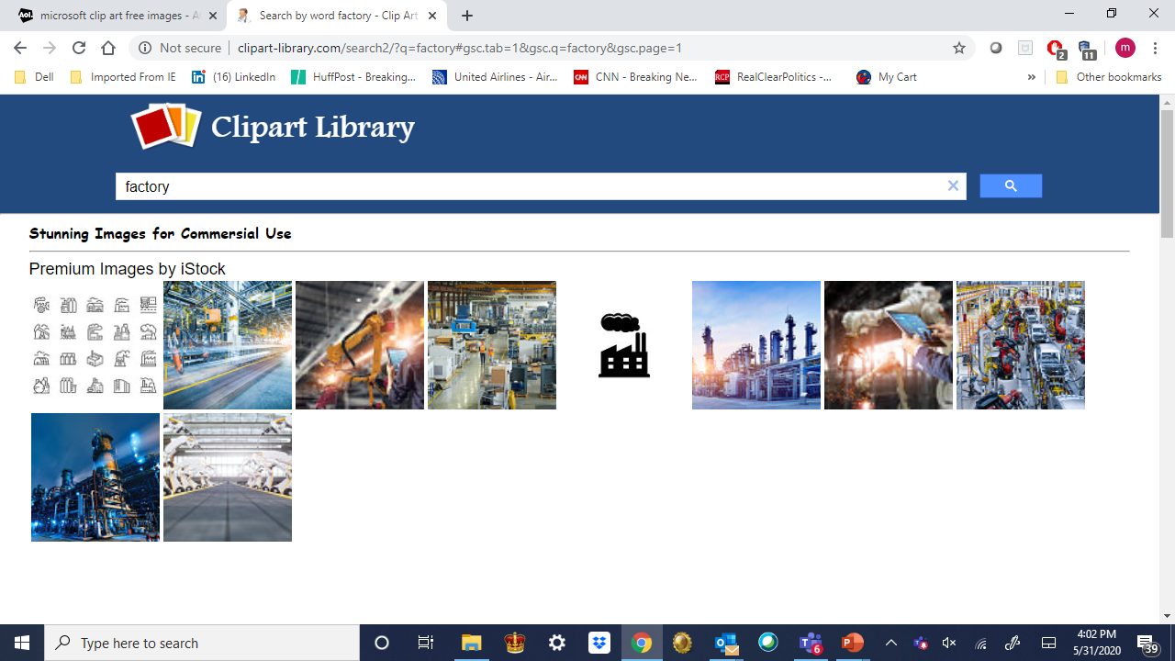
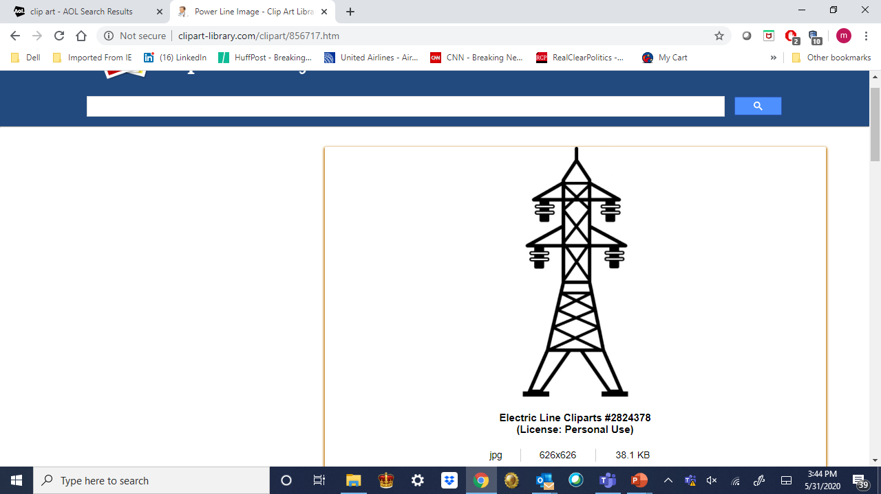
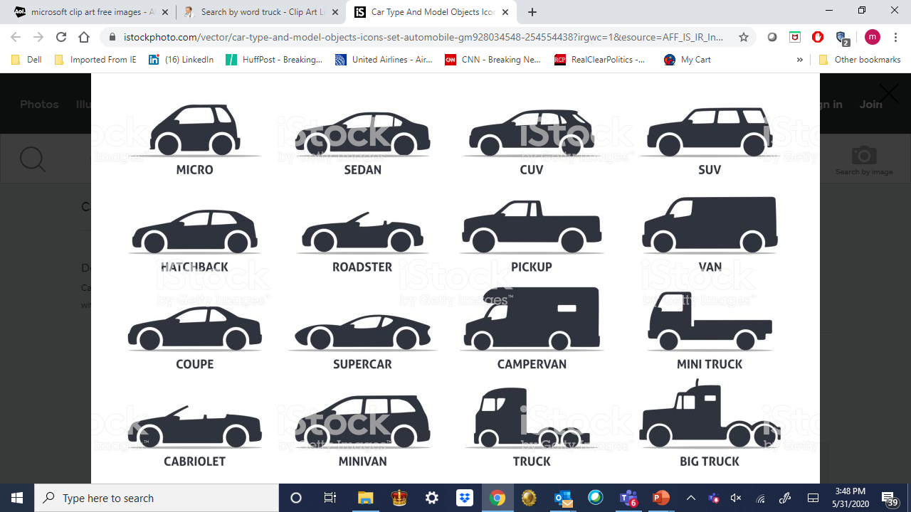
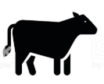

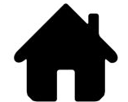
Emissions Sources by Economic Sector, US & New England
16%
28%
23%
22%
39%
29%
4%
8%
6%
9%
5%
CA
(2017)
5%
US
(2017)
Agriculture
Industry
Agriculture
Commercial
Residential
Electricity
Industry
Residential
Transportation
Electricity
Transportation
Commercial
-17%
+6%
-16%
+1%
+6%
+12%
+16%
-1%
-2%
+4%
+12%
-13%
45%
10%
17%
6%
NE
(2016)
15%
7%
Transportation
Electricity
Industry
Non-energy
Commercial
Residential
Source: EIA Website, accessed 02/18/20
California Study

Slide 7
Challenges with Integrating Intermittent
Renewables in California
Significant Challenges for Utility Scale Battery Storage
Over the course of a year large-scale dependence on both wind and solar will result in significant periods requiring very large-scale back-up options
1
2
4
8
9
10
3
5
6
7
11
12
13
14
15
16
17
18
19
20
21
22
23
24
26
25
27
28
29
30
31
32
35
34
33
36
38
37
40
42
39
41
43
44
45
46
47
48
49
50
51
52
53
54
55
56
57
58
59
60
61
62
63
64
65
66
67
68
69
70
71
72
73
74
75
76
77
78
79
80
81
82
83
84
85
86
87
88
89
90
Source: CAISO data, EFI analysis
Hourly trends in solar and wind capacity factors in CA for 2017 aligned to normalized variation in hourly load relative to peak daily load

Slide 8
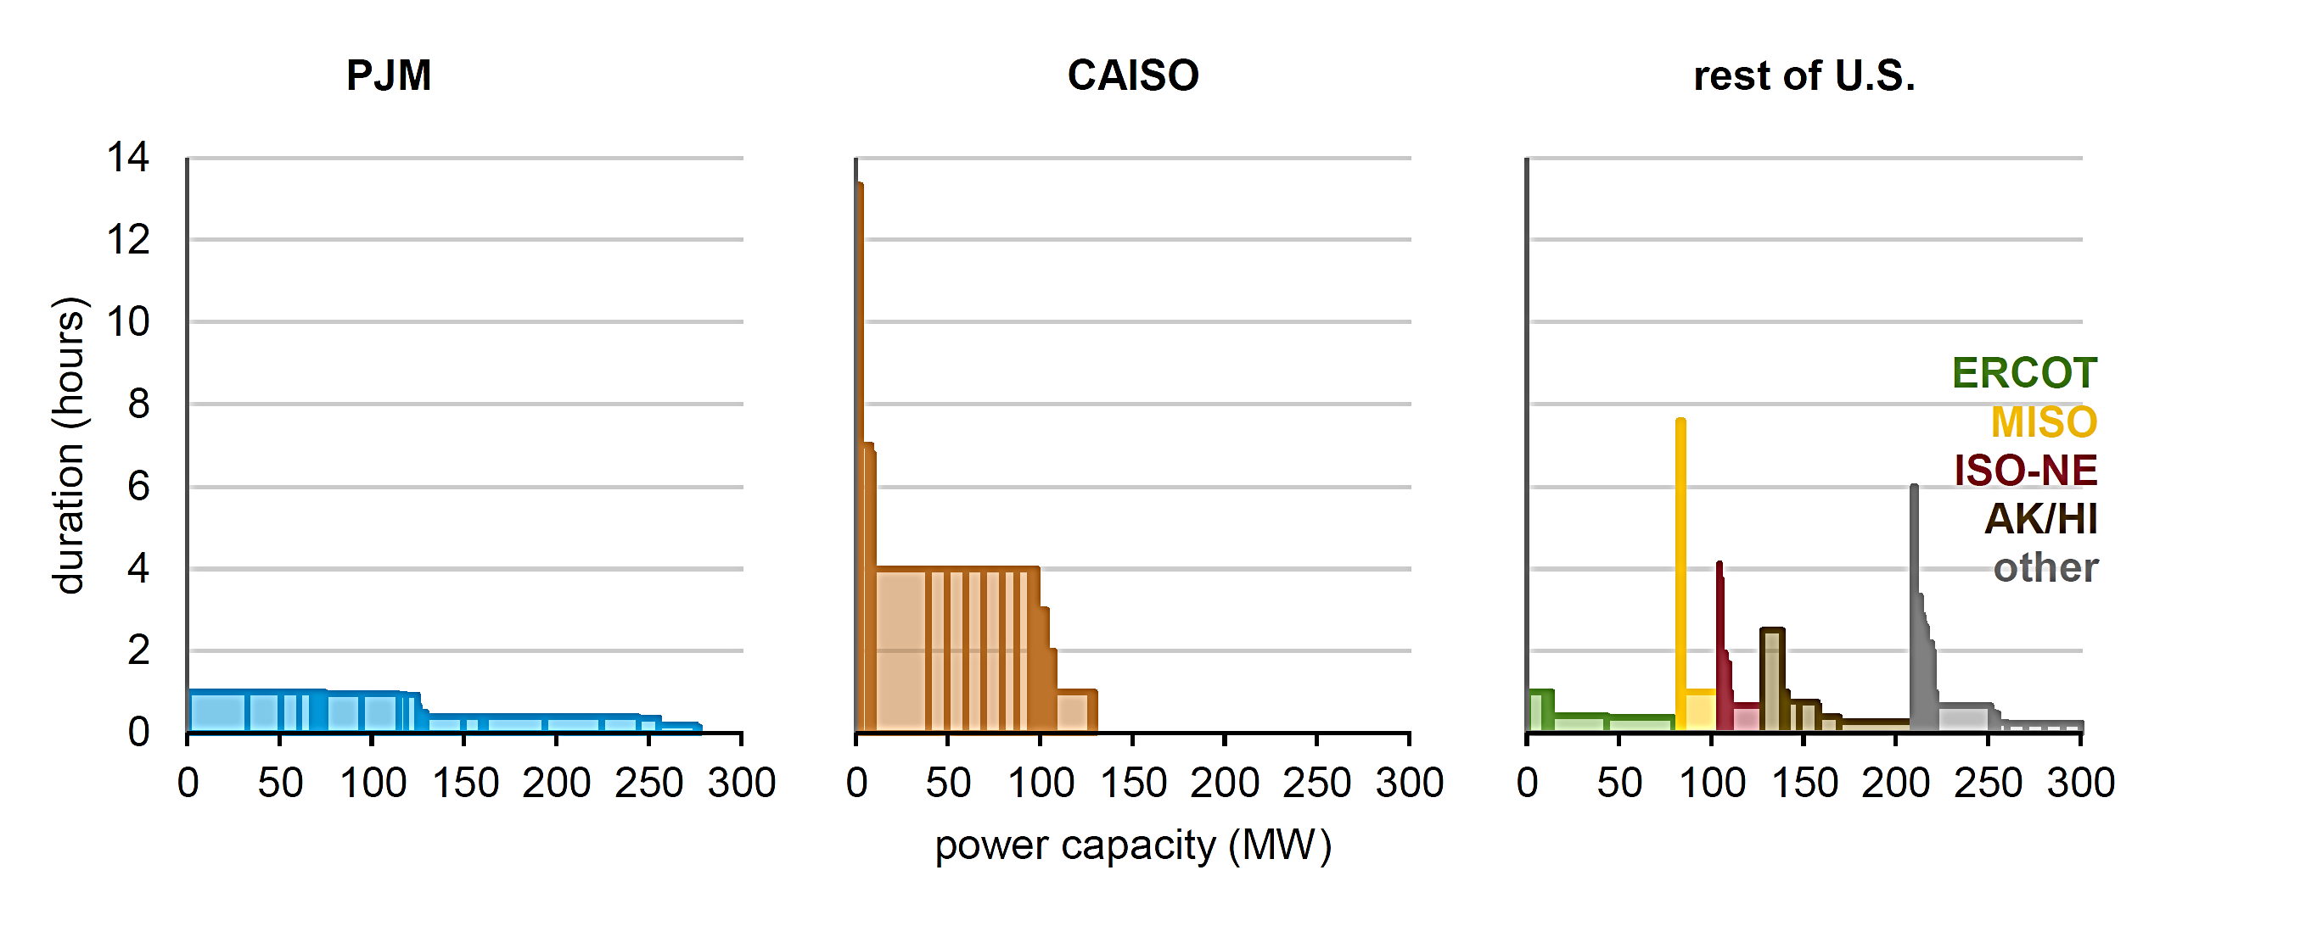
Challenges with Integrating Intermittent Renewables: Electricity Storage Capacity by Region, 2017
Significant Challenges for Utility Scale Battery Storage
Source: EIA, 2018
California Study

Slide 9
Identified Emissions Reduction Potential of Sector- Specific Pathways for Meeting CA’s 2030 Targets
No in-region sequestration options
Electricity
Transportation
Industry
Buildings
Agriculture
Electricity
Transportation
Industry
Buildings
Agriculture
Source: EFI analysis
Source: EFI analysis

Slide 10
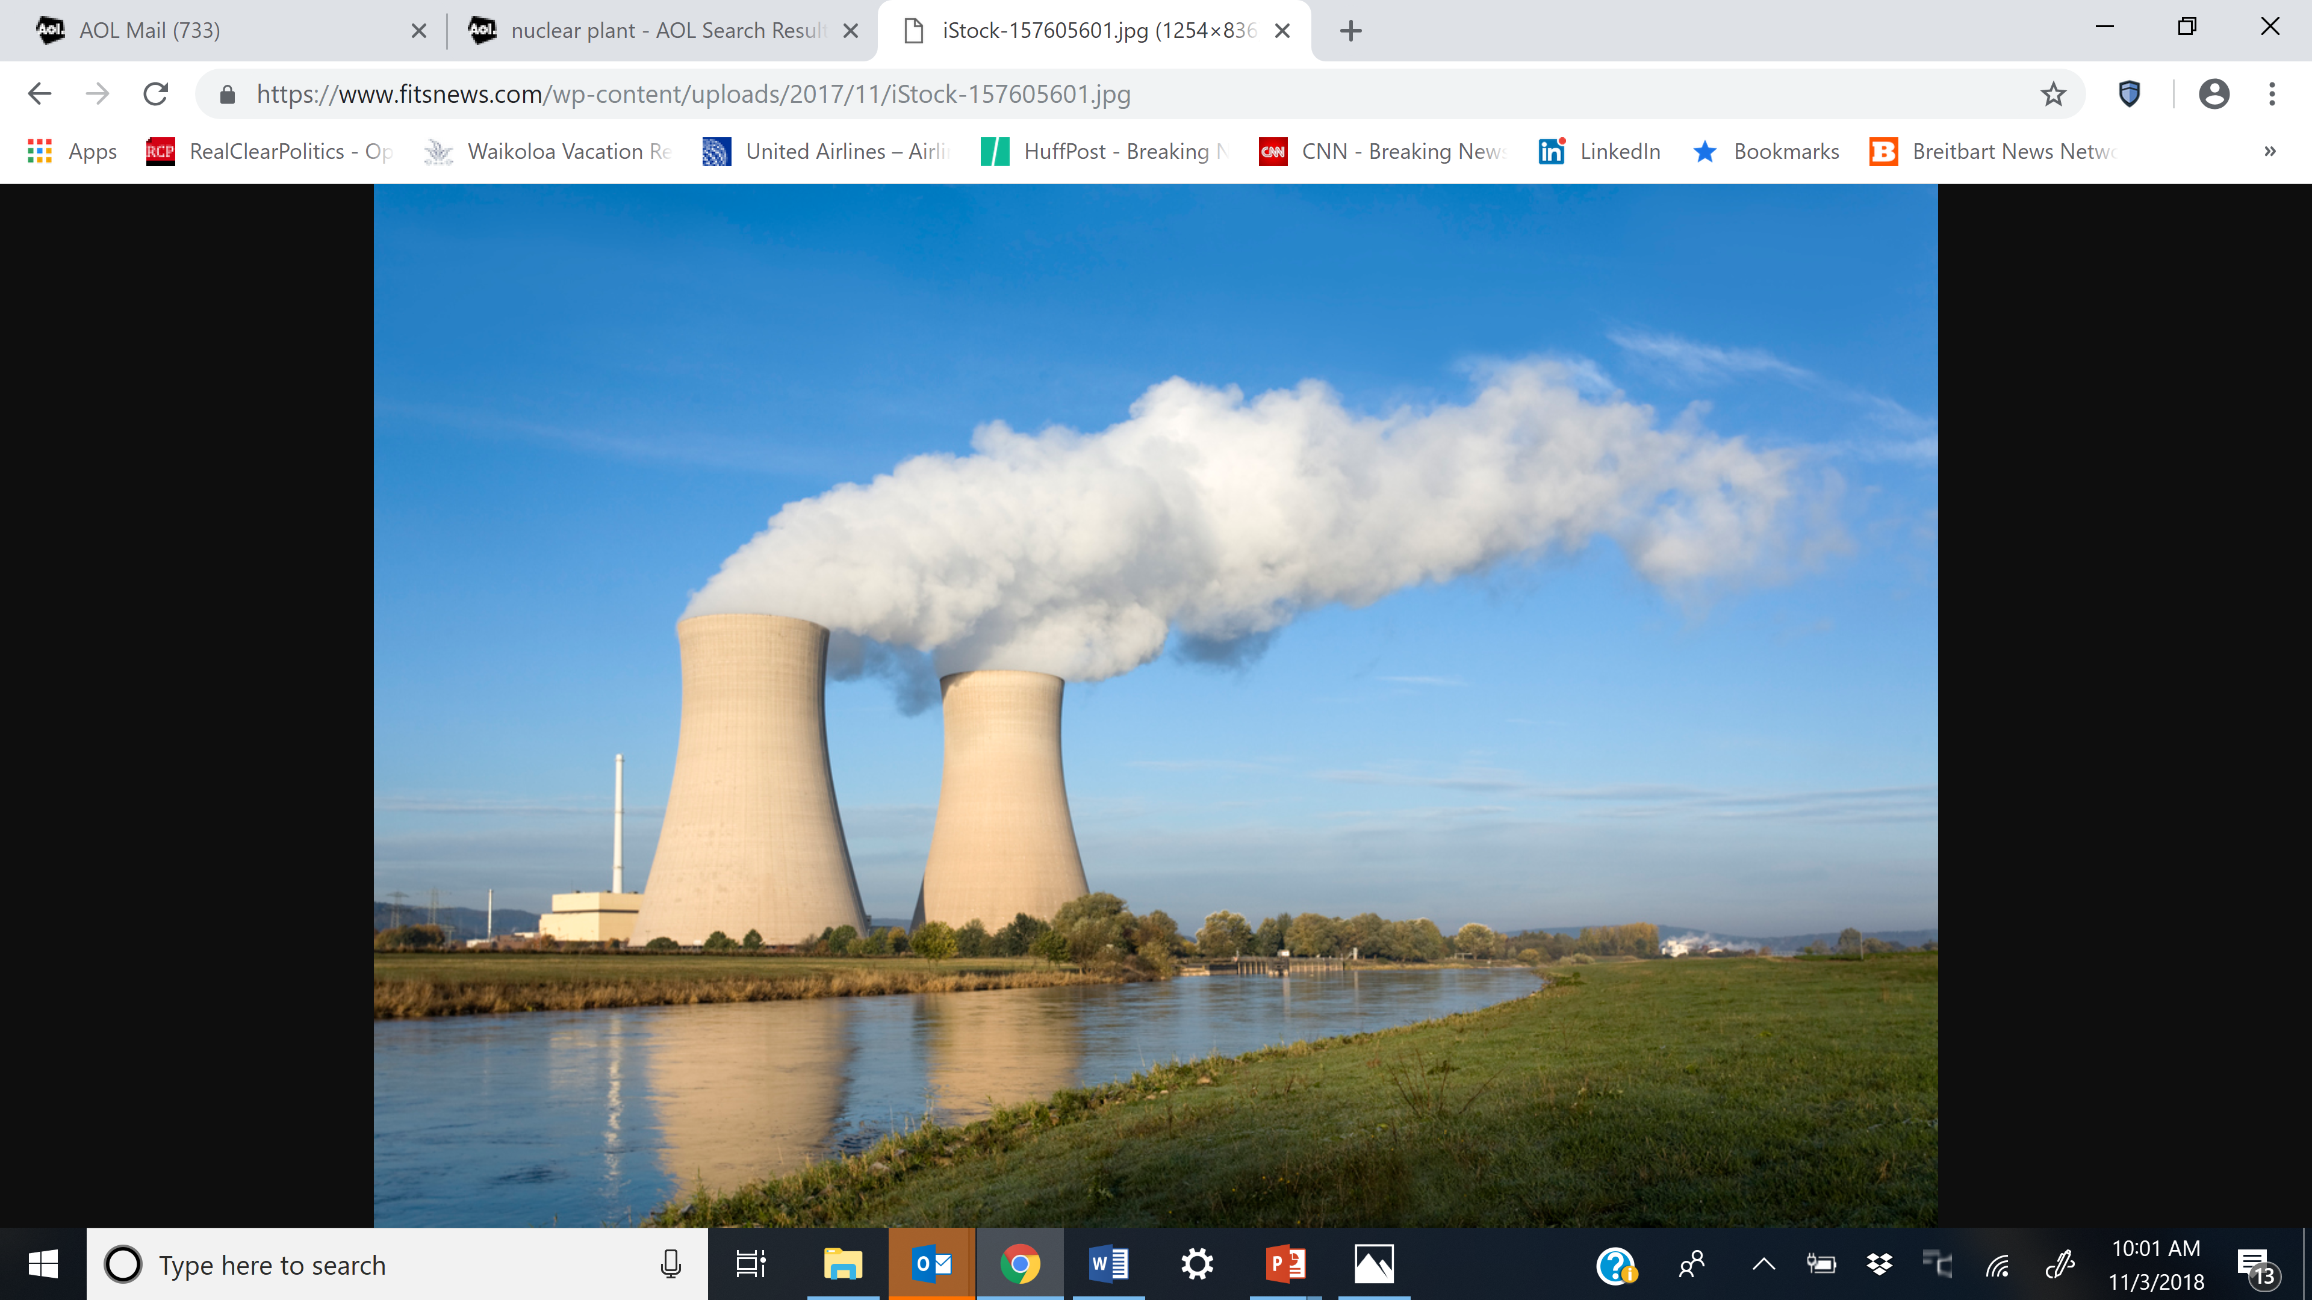
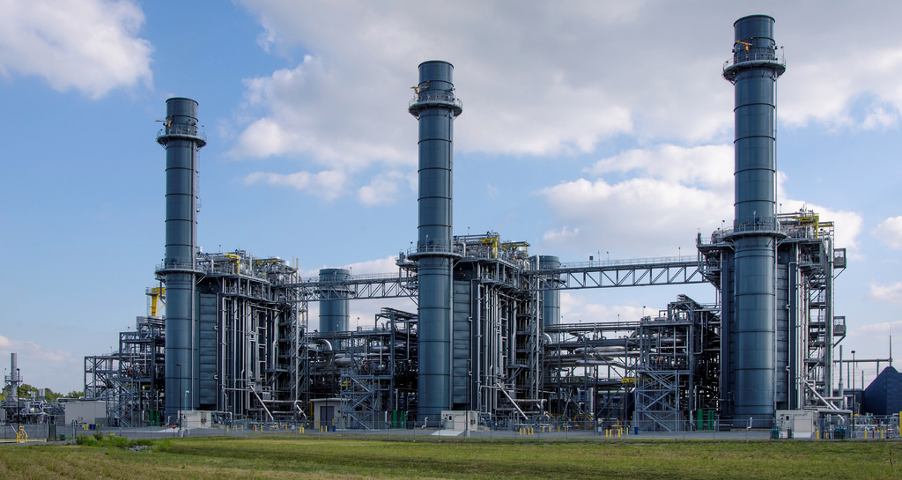
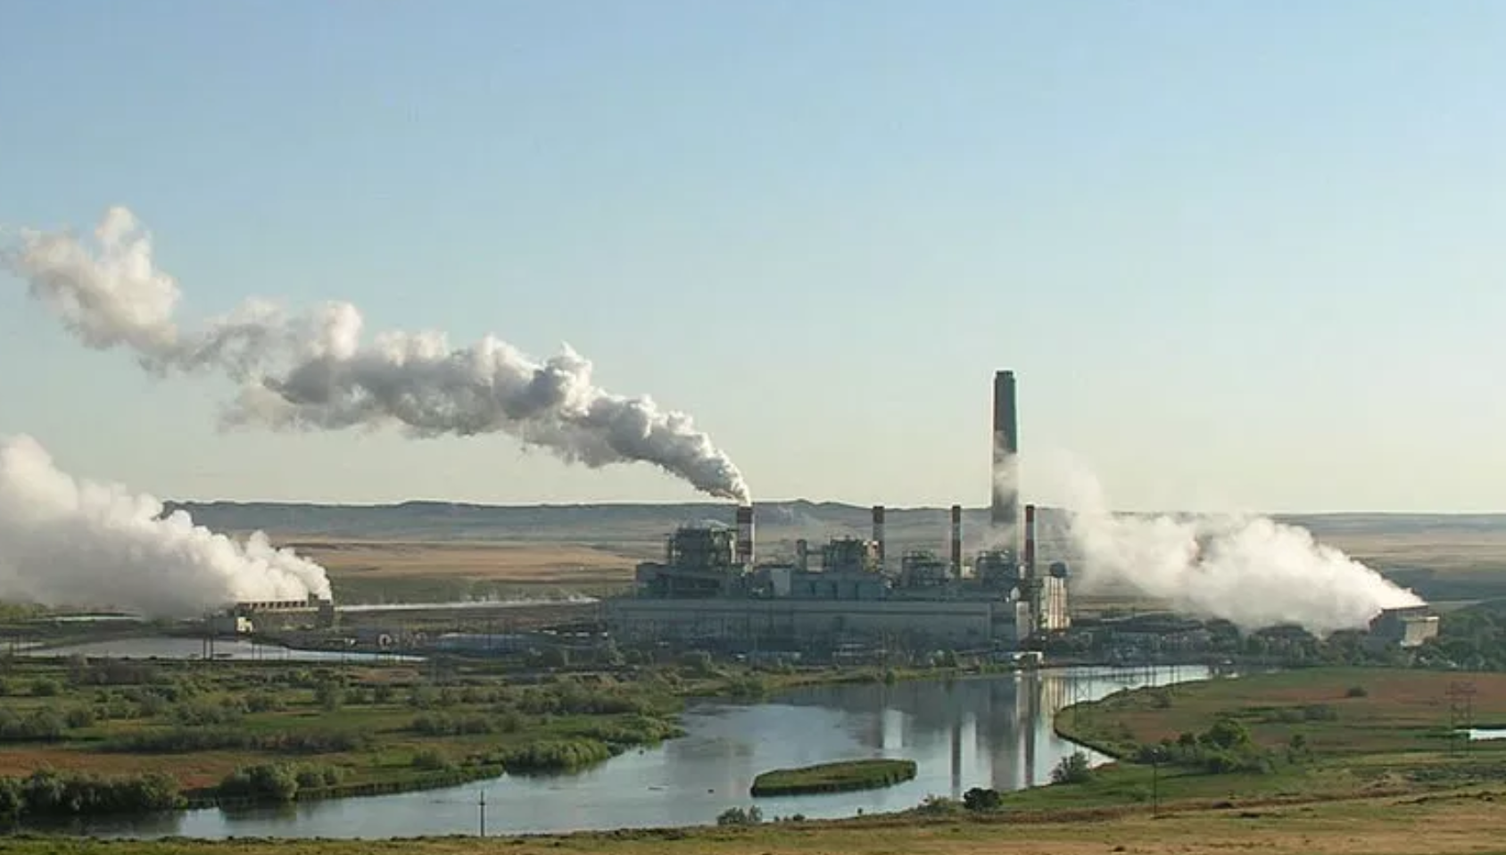
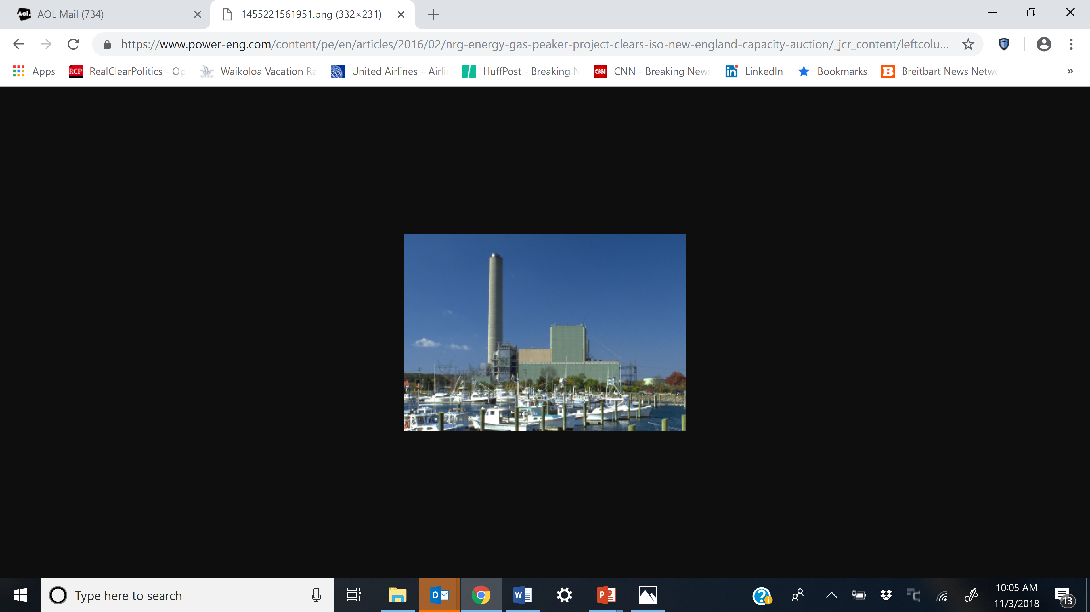
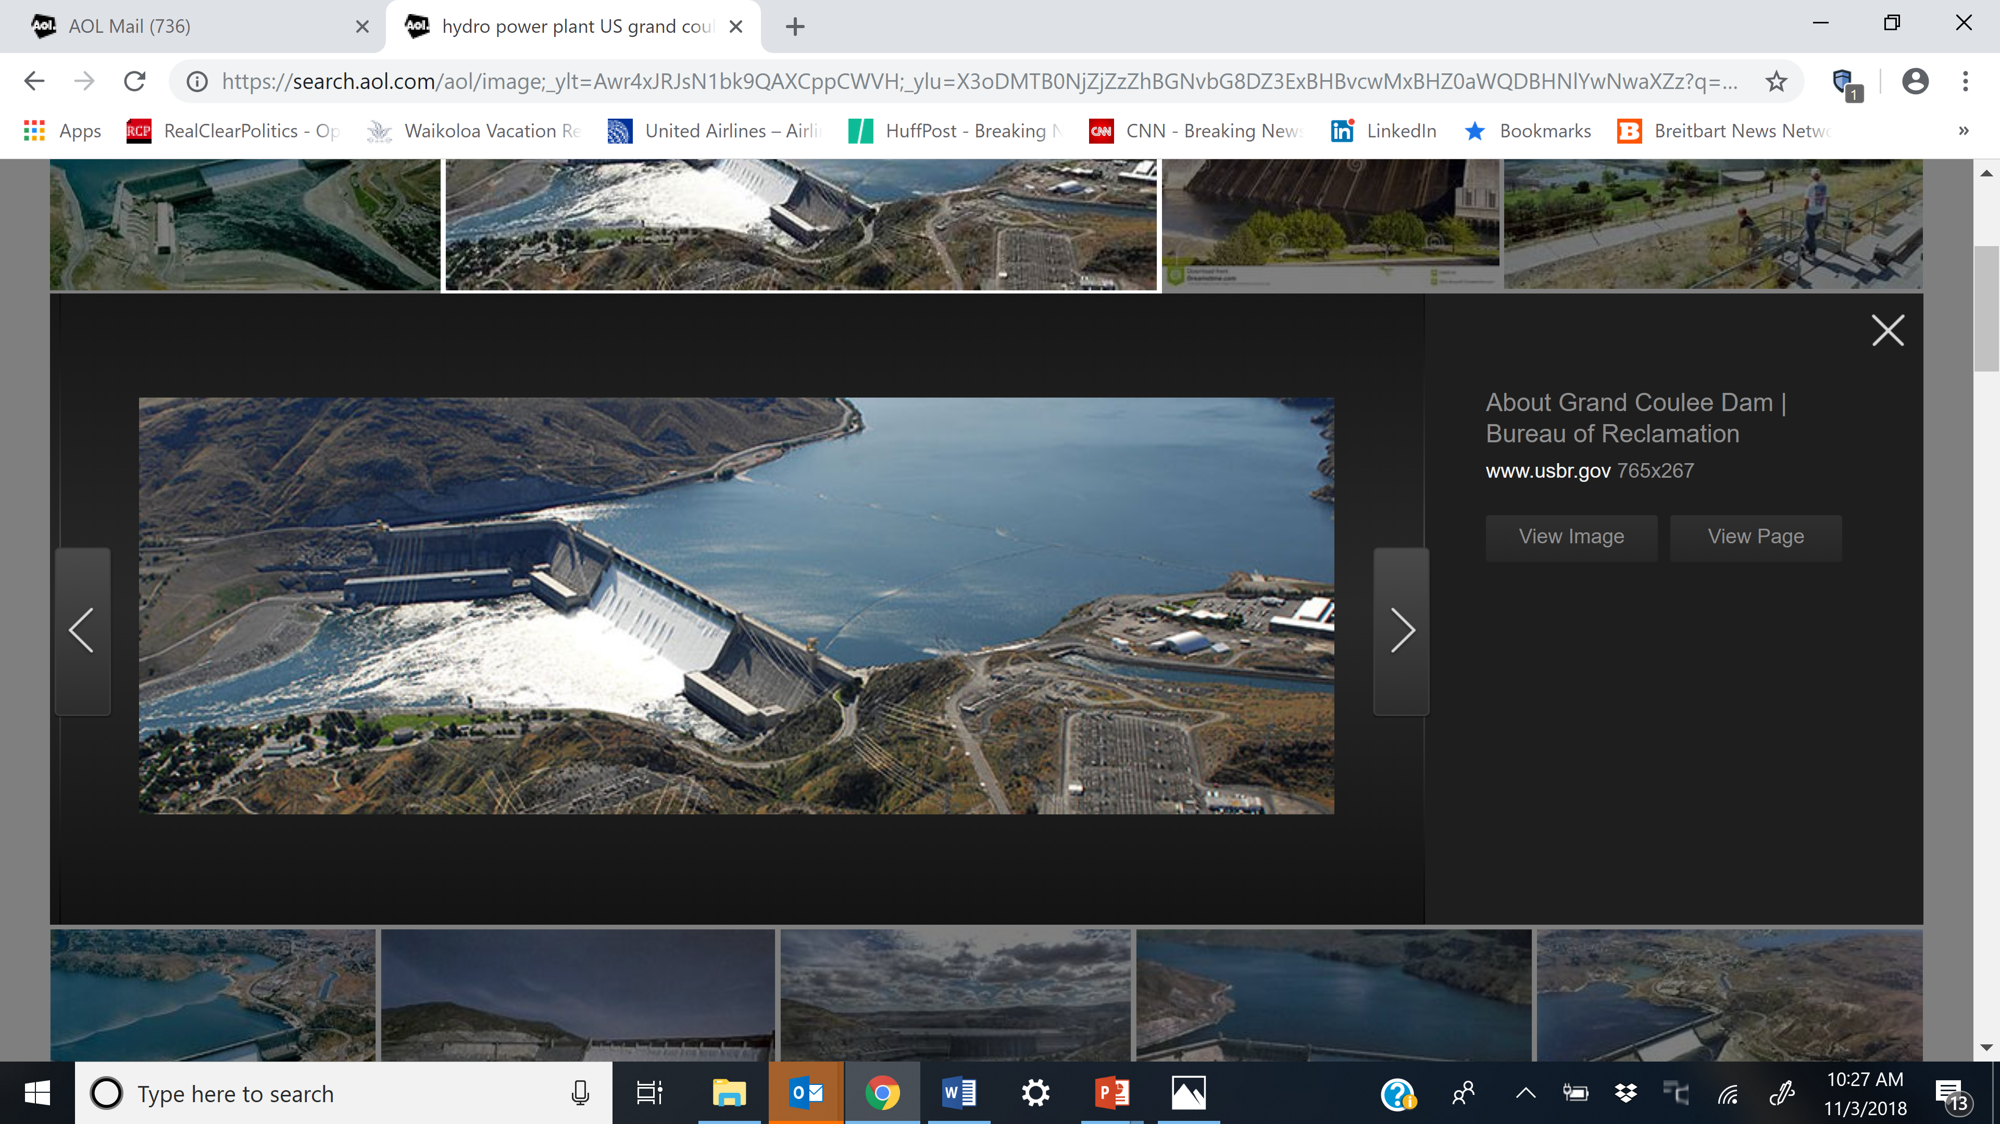
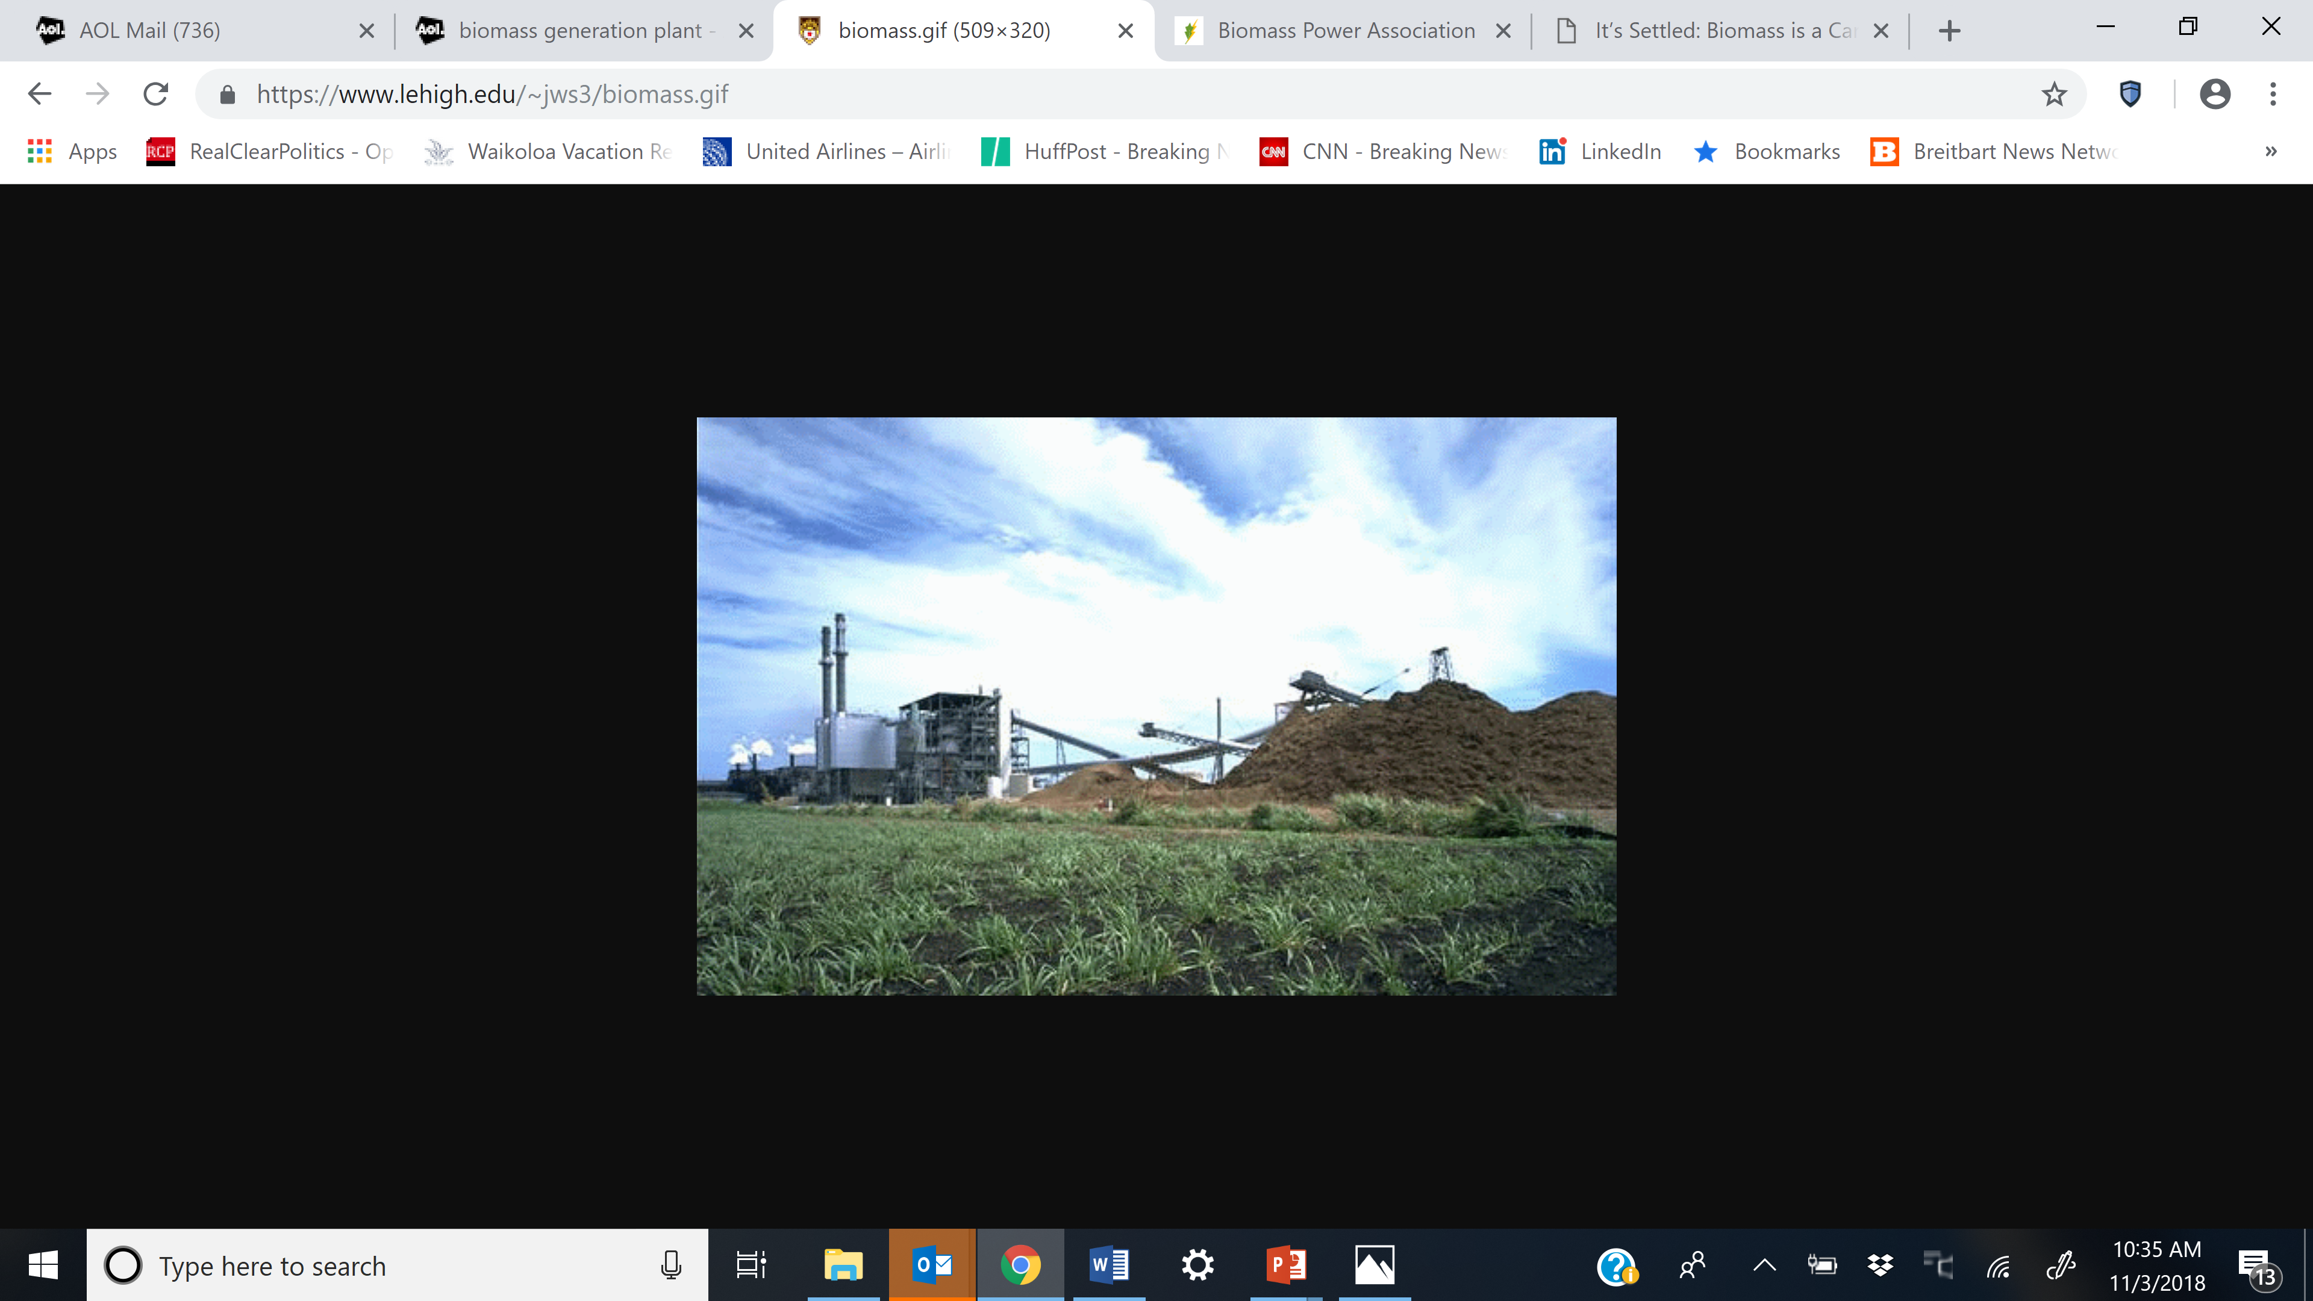
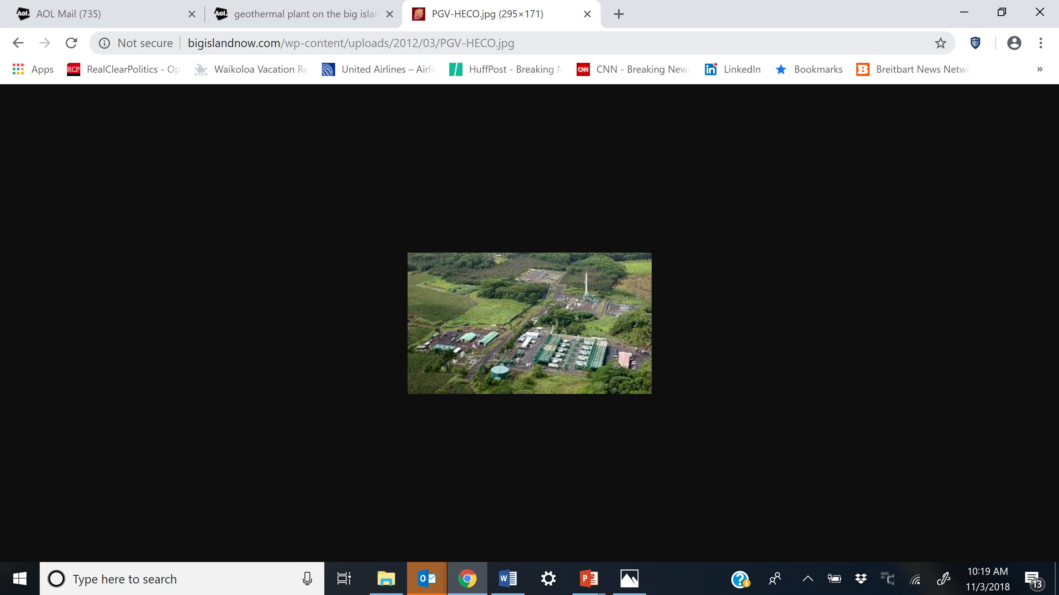
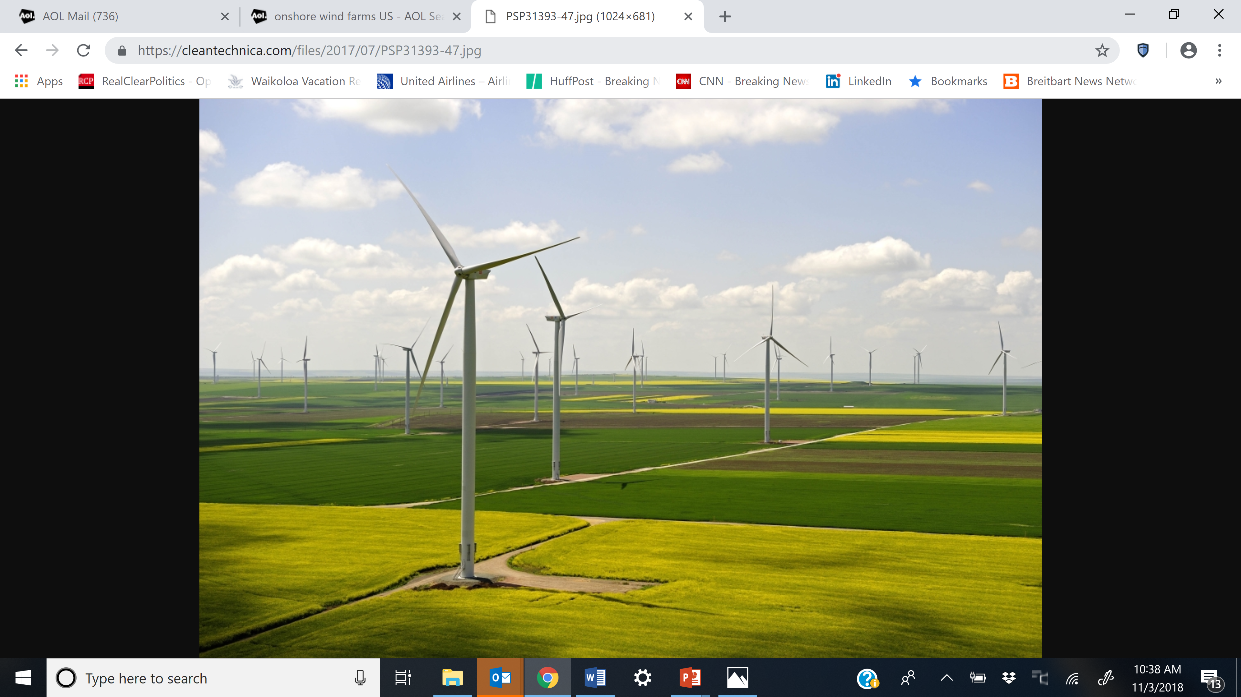
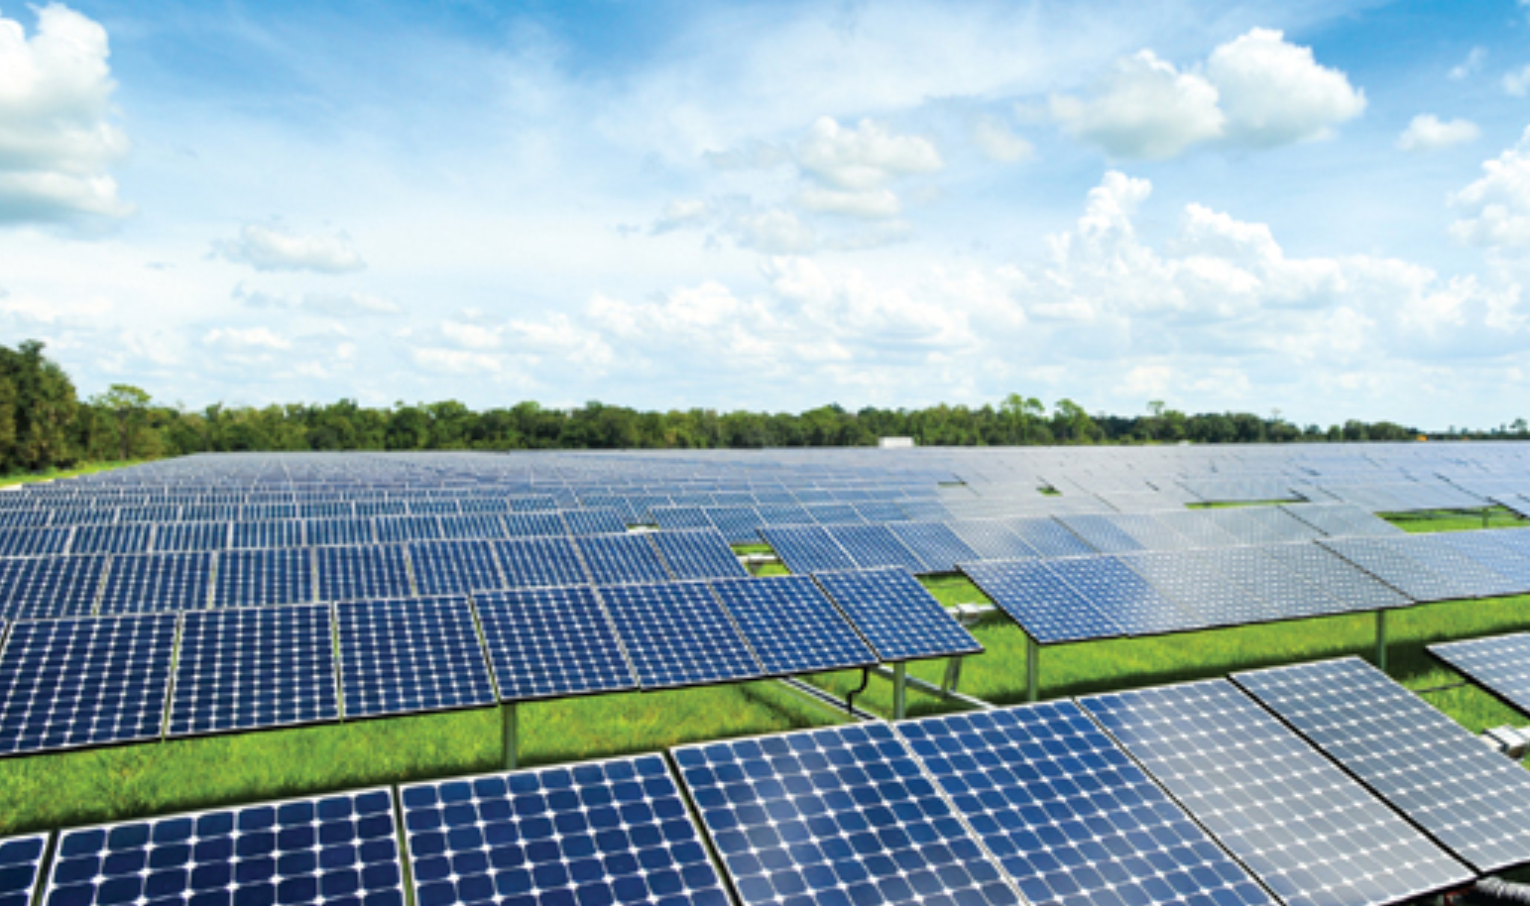
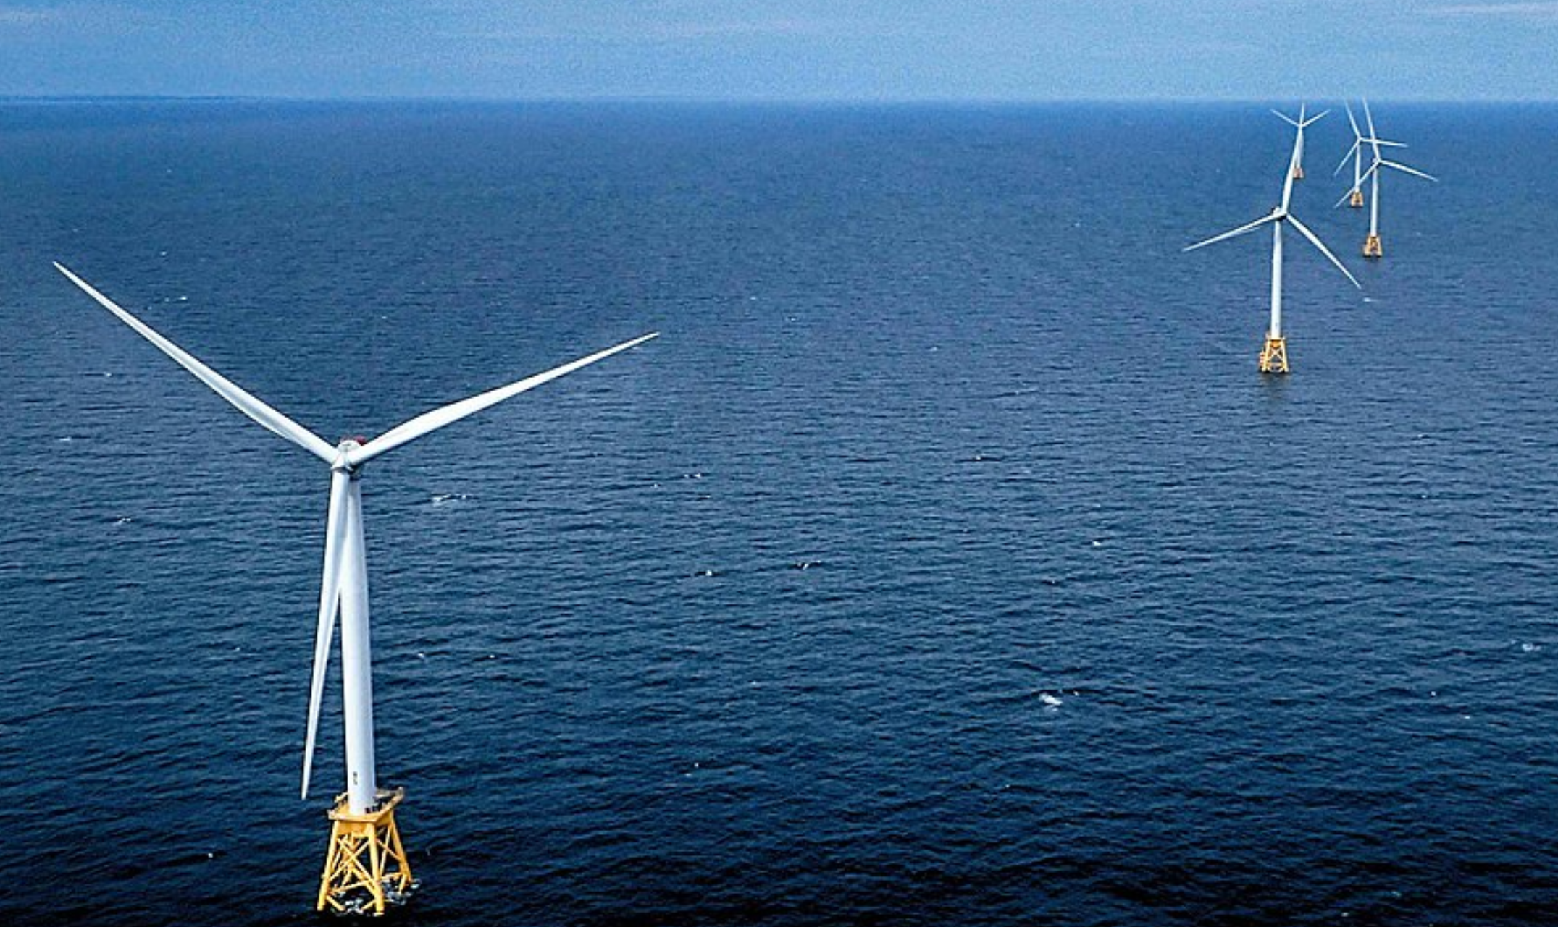
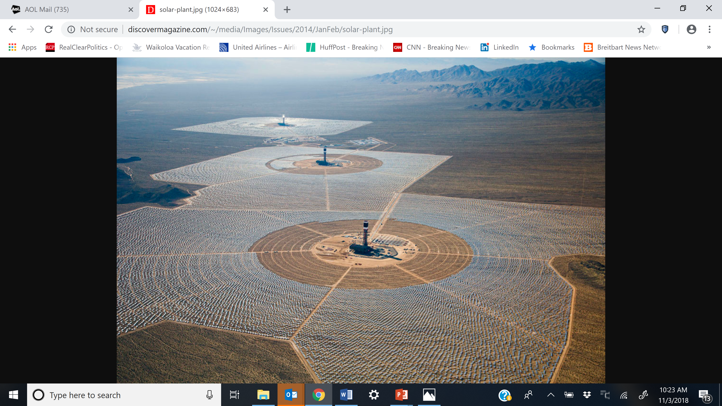
Two Views of LCOE: Generation Technologies, LCOE for Plants Entering Service in 2022 & LCOE/LCOS ($MWh), 2018
Advanced Nuclear
$92.6
Advanced CC
$48.1
Advanced CC w/ CCS
$74.9
Coal with 30% CCS
$130.1
$44-$68
$118-$192
NGCC
Nuclear
$32-$42
Solar PV, thin film
$150-$199
$85.1
$95.3
Advanced CT
Hydroelectric $61.7
Biomass
Geothermal
$44.6
Gas peaker
$126-$156
Solar thermal w/storage
Unsubsidized Levelized Cost of Storage
$59.1
Lithium
$165.1
Onshore Wind
$63.2
Offshore Wind
$138.0
Solar Thermal
Solar PV
Utility-Scale
(PV + Storage)
Flow (Zn)
Source: Lazard, Levelized Cost of Storage Analysis, Version 4.0, 2018
Flow (V)
Source: Lazard, Levelized Cost of Energy Analysis, Version 4.0, 2018
LCOE Source: EIA
Notes:
2022
Advanced NGCC with CCC only $26 higher than without and $16 higher than onshore wind, $12 higher than solar PV (these numbers are without storage)
Avanced NGCC $74.90
Onshore wind 59.10
Solar PV $59.10
Don’t include storage
Keep these numbers in mind for a few minutes
. Read storage costs

